Slide 1
Everything About Influencer Marketing
Mahesh Gangurde

Slide 2
What Is Influencer Marketing
Love it or hate it, influencer marketing is still a numbers game, no matter what types of social media platforms you look at
Influencer marketing uses influencers to represent products, services, campaigns on behalf of brand or a business.
Social Media Influencer :
A social media influencer is someone who has established credibility in a specific industry, has access to a huge audience and can persuade (convince) others to act based on their recommendations.
Influencer Marketing Is The Process Of Identifying, Researching, Engaging And Supporting The People Who Create High-impact Conversations With Customers About Your Brand, Products Or Services

Slide 3
In Short Influencer Marketing Is
When an influencer recommends a product or service on their channels, it can come across as a trusted recommendation from a friend. So it is great way to raise awareness about a new product line or campaign we're running.

Slide 4
Types of Influencer
Different Types of Influencers Based on Follower Count
1: Micro-influencers: Number of followers: 5,000 — 100,000
2: Mid-tier influencers: Number of followers: 100,000 — 500,000
3: Macro-influencers: Number of followers: 500,000 — 1M
4: Mega-influencers: Number of followers: 1M+

Slide 5






Types of Influencers By Types of Content
Blogger
Youtuber
Podcasters
Industry Expert
Celebrities
Journalists
Academics
Professional advisors

Slide 6
What can Influencers do for your brand?
1
2
The ability to reach out to wide segments of the audience. Influencers will give you access to their audience besides your existing audience. With influencer marketing, you can generate brand awareness among new segments through influencers’ follower bases.
Influencers have developed a relationship of trust and loyalty with their followers. As a result, influencer marketing will add the element of credibility to your brand. More credibility will provoke people to give your products a try.

Slide 7
What can influencers do for your brand?
3
4
Influencer marketing also helps in word-of-mouth marketing on social media. Because influencers have many followers, their social media activity is always on their radar. Every new thing or brand they support is likely to generate conversations. Particularly if they collaborate with brands through impactful campaigns, the word can spread like fire, in the favour of your brand.
Lastly, influencers are known content creators for particular niches and any brand they will support will automatically gain credibility. Expertise too contributes towards building credibility and thus a good name for the brand.

Slide 8
How to find the right influencer for your business?
Finding the right influencers for our marketing campaign can be a big challenge. if our goal is to rack up a lot of engagement, it might make sense to partner with micro-influencers with smaller audience but higher engagement rates.
For Example.
You Are The Small Business Owner Of A Company That Designs & Manufactures Make-Up Products
You Find An Influencer In That Niche. A Blogger With An Instagram Following Numbering In The Tens Of Thousands.
This Person Tries New Makeup Styles And Products, And Reviews Them And Models Them For Their Followers. Their Followers, In Turn, Are Highly Influenced To Buy And Try These Products For Themselves.

Slide 9
How do social media influencers make money?
Influencers help businesses grow, so brands are willing to pay for their support.
Influencers make money with sponsored promotions.
Influencers make money by managing social media accounts.
Sponsored promotions are when a brand pays a social media star to create content on its behalf to share with their followers. Sponsored promotions include product placements, brand stories, event coverage, product reviews and more.
Social media influencers are in demand to act as a brand’s social media manager. .Celebrities, new brands and trending businesses capitalize on social media stars’ traction and trained eyes to manage their social accounts and market their products.

Slide 10
How do social media influencers make money?
Influencers help businesses grow, so brands are willing to pay for their support.
Influencers make money via YouTube channel ads.
Influencers make money through affiliate links.
Followers watch these ads when they visit the influencer’s YouTube channel. Additionally, social media stars can make money through sponsored content brand videos they display on their YouTube channel.
Social media stars earn a portion of the revenue generated by affiliate links. It’s best to choose affiliate links for products that appeal to the influencer’s audience and match their aesthetic.

Slide 11
How do social media influencers make money?
Influencers help businesses grow, so brands are willing to pay for their support.
Influencers make money through merchandising.
Influencers make money from subscriptions, tipping and donations.
Social media influencers can also sell their own merchandise online. For example, artists can sell prints of their artwork and interior designers can sell ebooks with design tips. Social media stars can also create products branded with their name, like T-shirts.
Followers can pay monthly to subscribe to this content. .Followers also sometimes give one-time tips or donations when the mood strikes them.

Slide 12
How do social media influencers make money?
Influencers help businesses grow, so brands are willing to pay for their support.
Influencers make money by becoming brand ambassadors.
Brand ambassadors are influencers who have signed an exclusive contract with a brand. They essentially become a spokesperson for the brand. Brand ambassador contracts generally cover a specified period where the influencer promotes the brand on various platforms and via various online and offline methods. Influencers are usually paid a lump sum upfront.

Slide 13
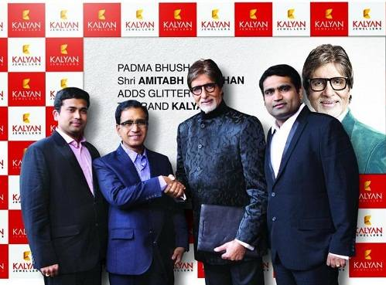
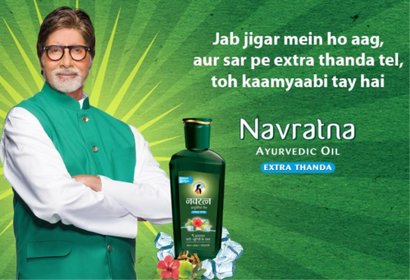
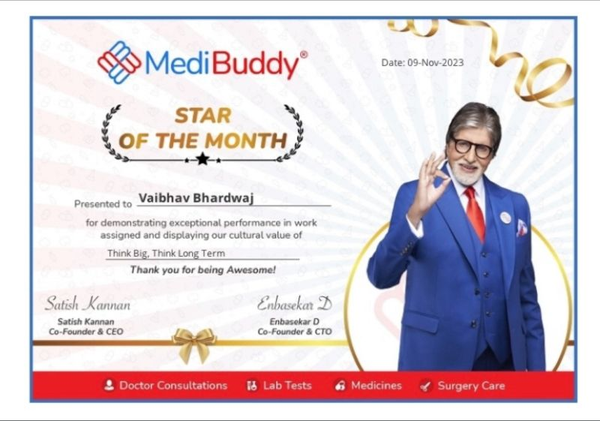
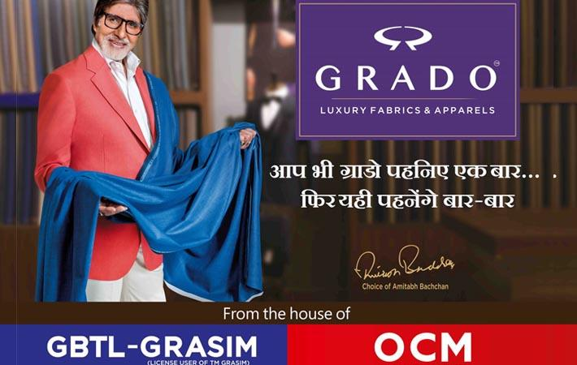
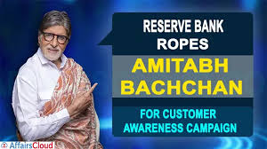

Slide 14
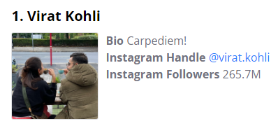
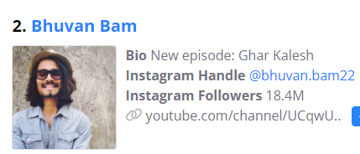
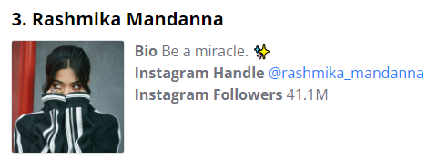
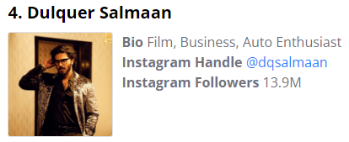
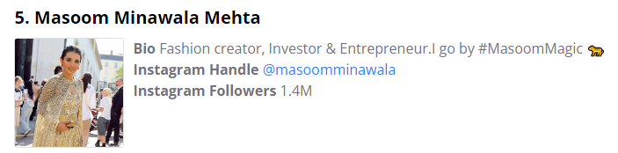
Top 5 Indian Influencers in 2024

Slide 15
THANK YOU!
Mahesh Gangurde

